Slide 1

Ketchikan Housing Market Analysis
For: The Ketchikan Gateway Borough, AK
By: Points Consulting
October 19th, 2023

Slide 2
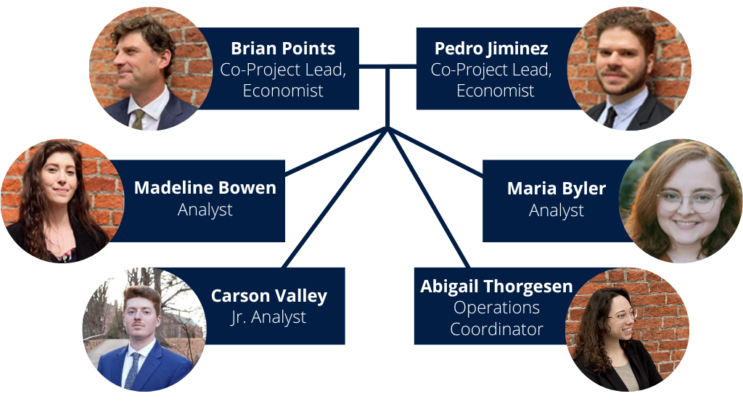
Intros to Our Team
multi-faceted real estate analytics practice
blend of public/private clients
socioeconomic and labor market analysis
both local and national presence
land use & GIS expertise
Notes:
These are the actual people on the project (we don’t load up proposals with unassociated staff).
Highlights:
We have real experience in the region. I’ve been there numerous times on state contracts and one (Paddocks) for the city (probably back in 2017).
Enticing the private sector means understanding their economic structure and responding to it. Working on both sides of the pub/private divide helps us with that.
Coms:
Brian and Pedro- most of the time
Abby: contracts and invoicing

Slide 3
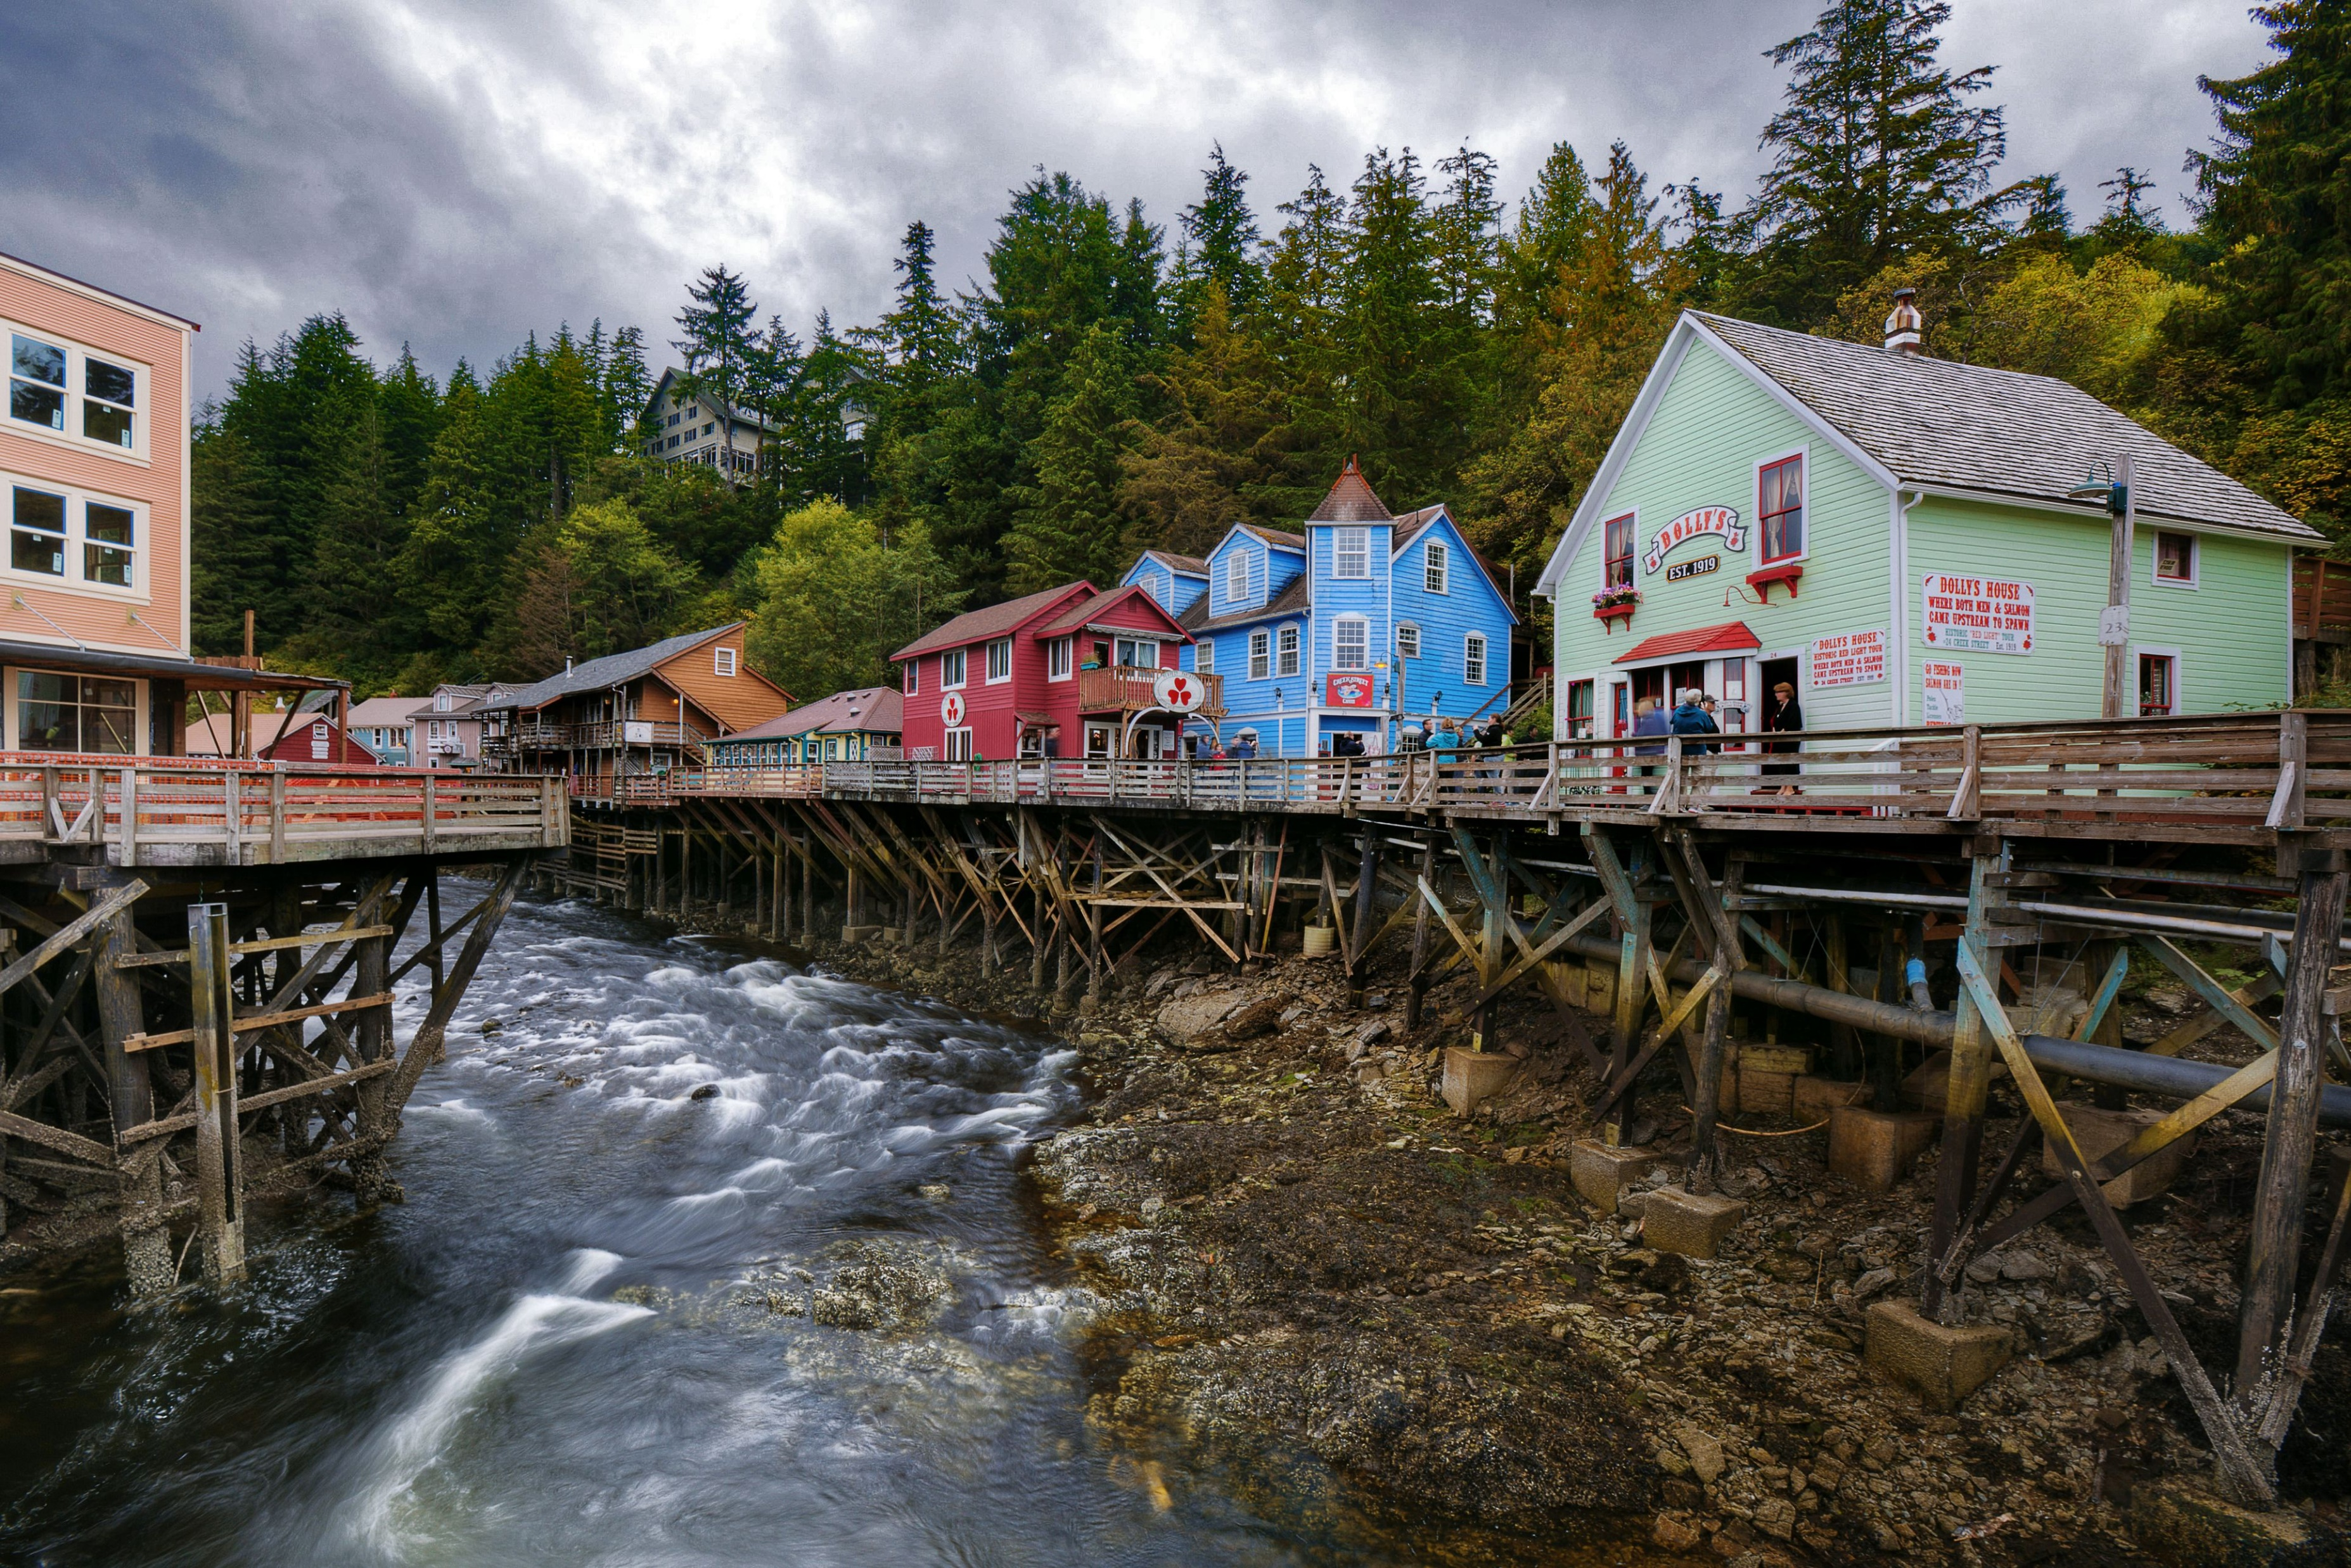
Scope of Work: Tasks 1-2
Task 1: Project Initiation & Background Research
identify stakeholders, contacts
collaboratively identify resources
discuss underlying trends and opportunities
project work plan
collection of permitting and GIS data from the city and Borough
review of planning documents
zoning ordinance and development codes
Task 2: Housing & Socioeconomic Assessment
demographic analysis
industry and workforce analysis
existing housing stock & supply
affordability and access
Ketchikan, AK (via tripsavvy.com)

Slide 4
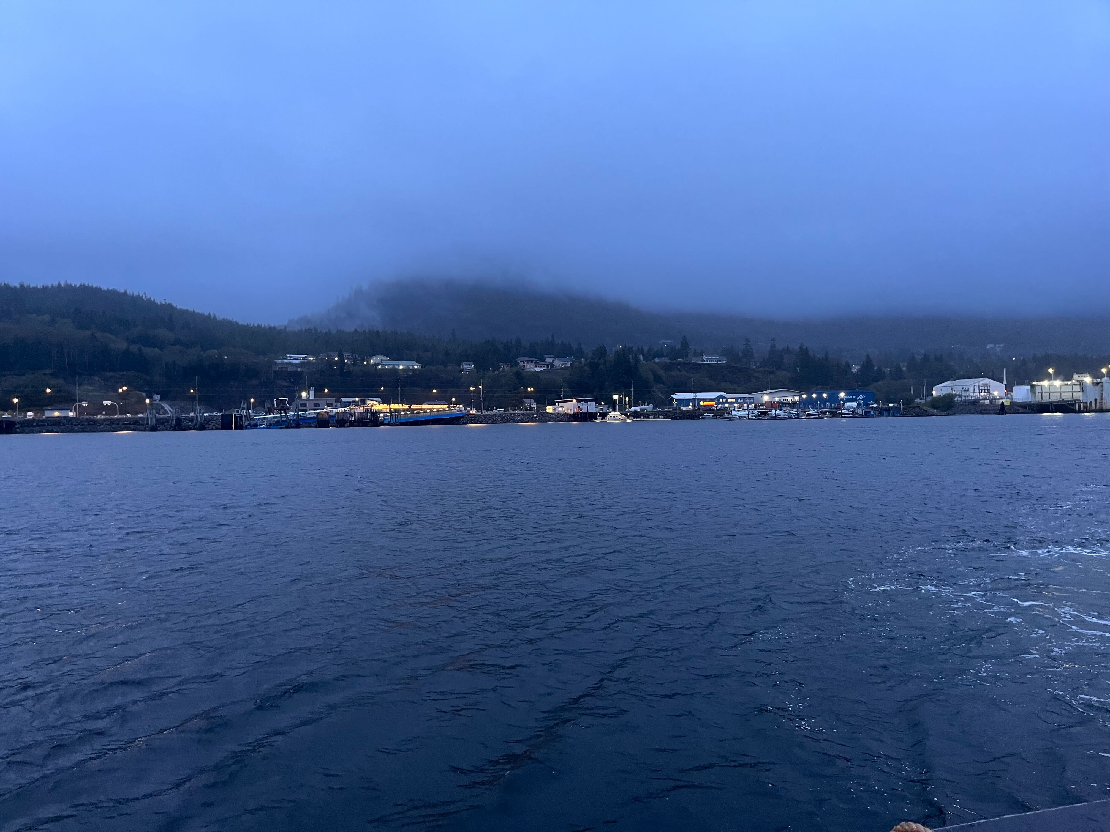
Scope of Work: Tasks 3-4
Task 3: Community Contextual & Topographical Assessment
planned developments
updated GIS analytics
drive-thru tour and site-review (Fawn Mountain property, etc.)
Task 4: Community Engagement
in-depth interviews
townhall meetings
community survey
PC On-Site visit, October 2023

Slide 5

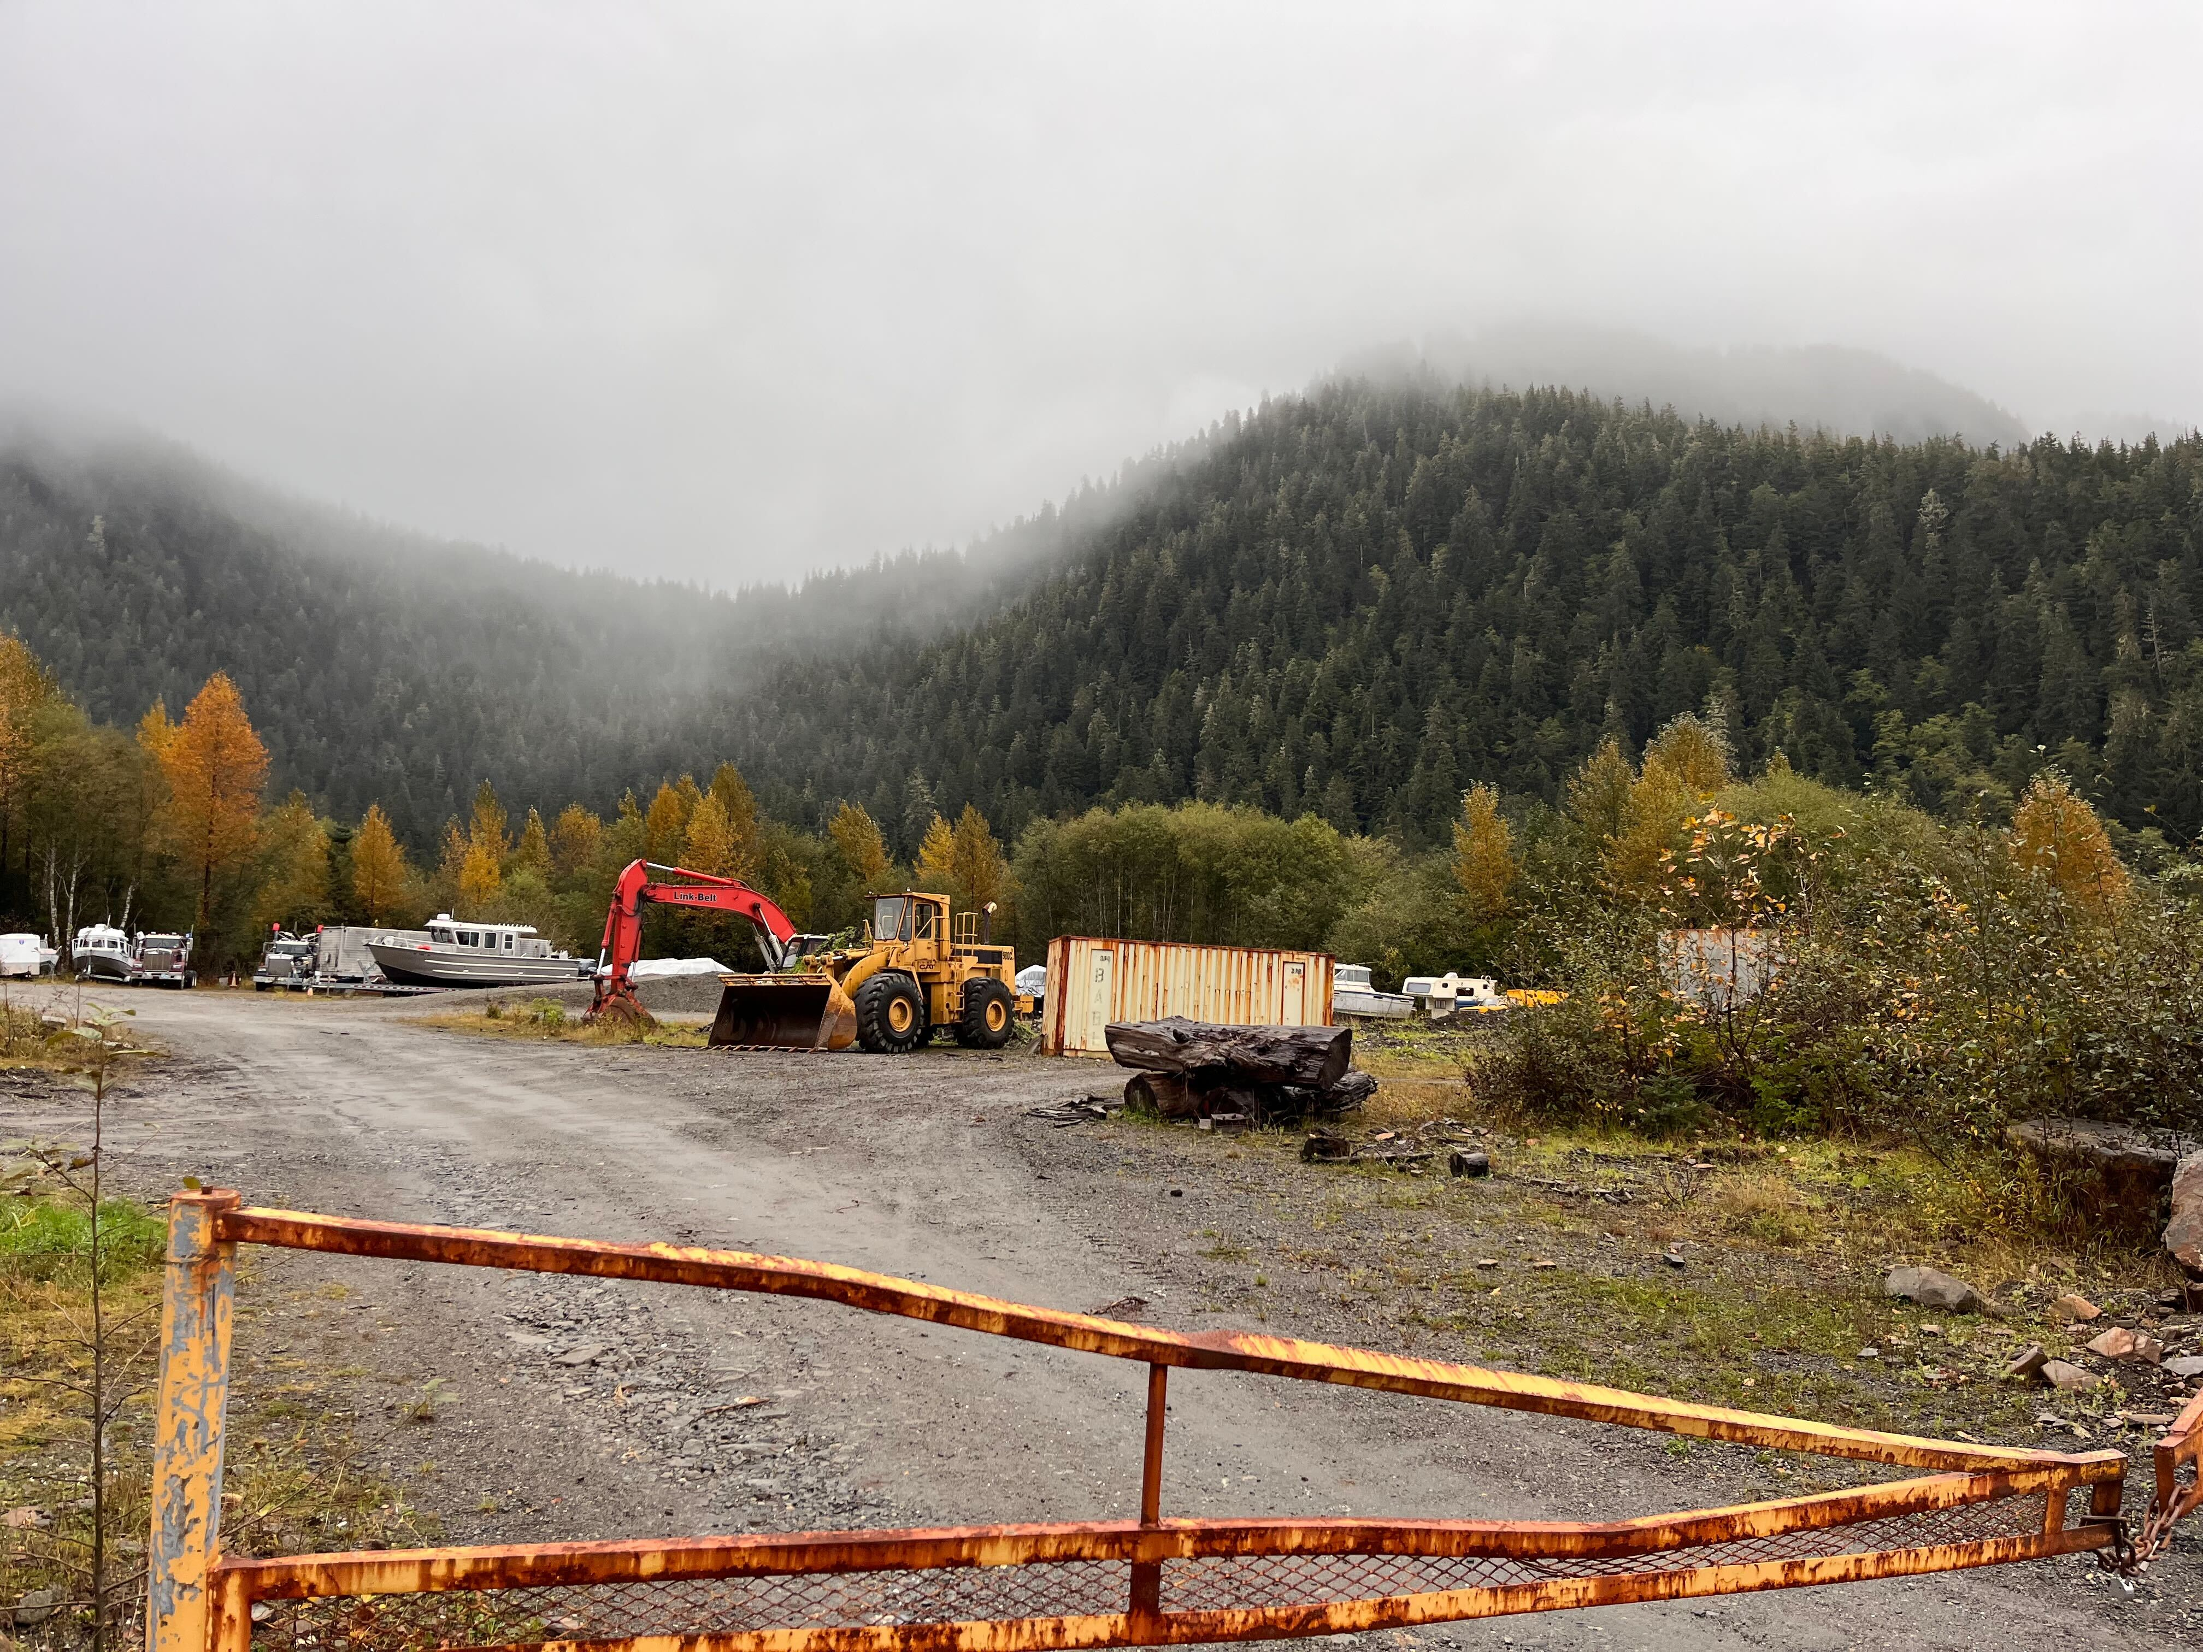
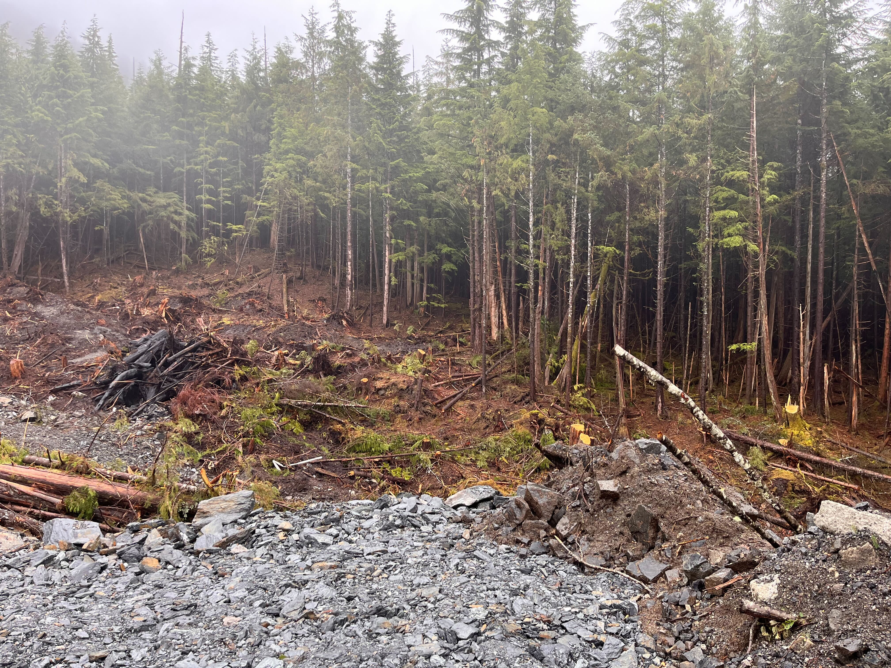
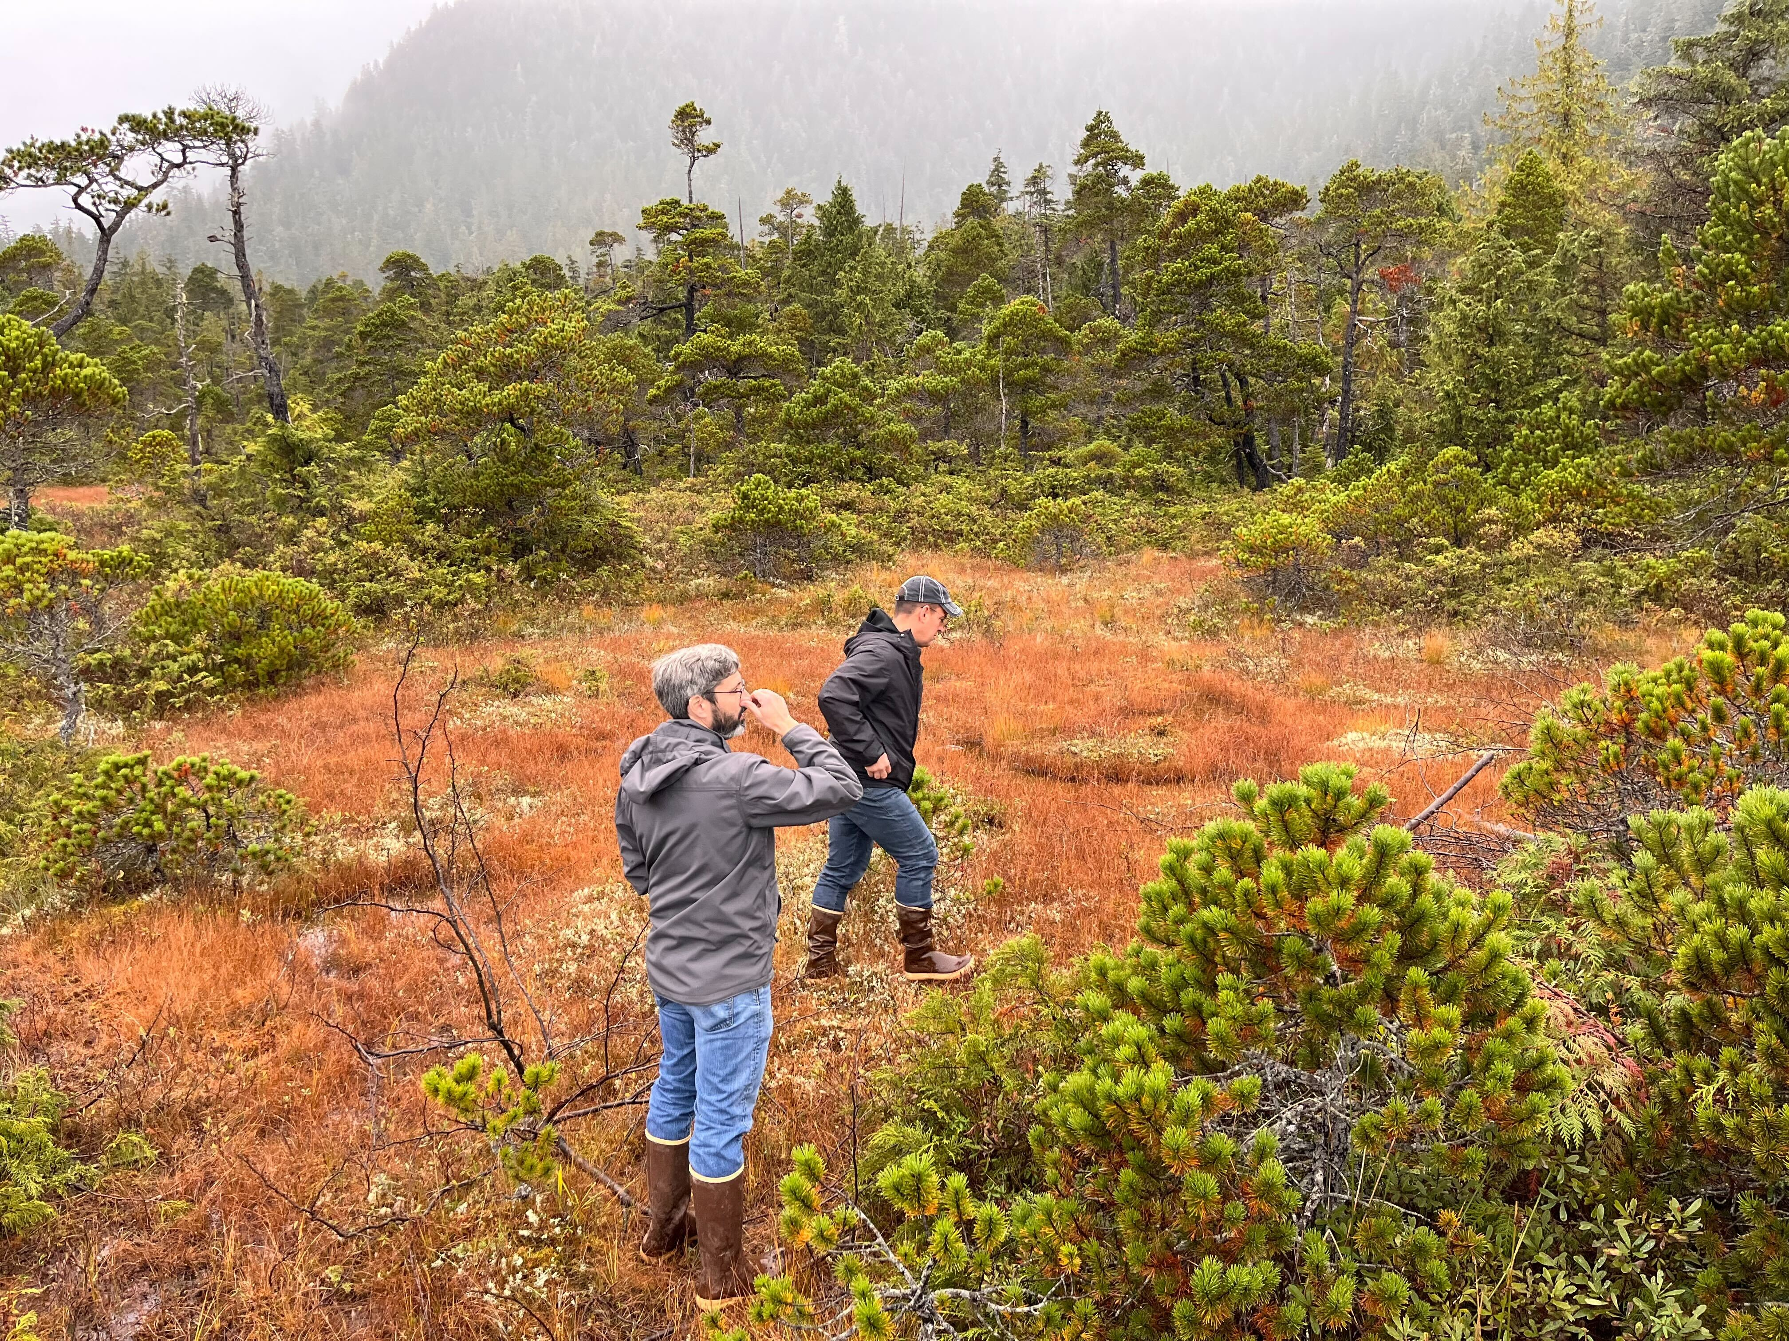
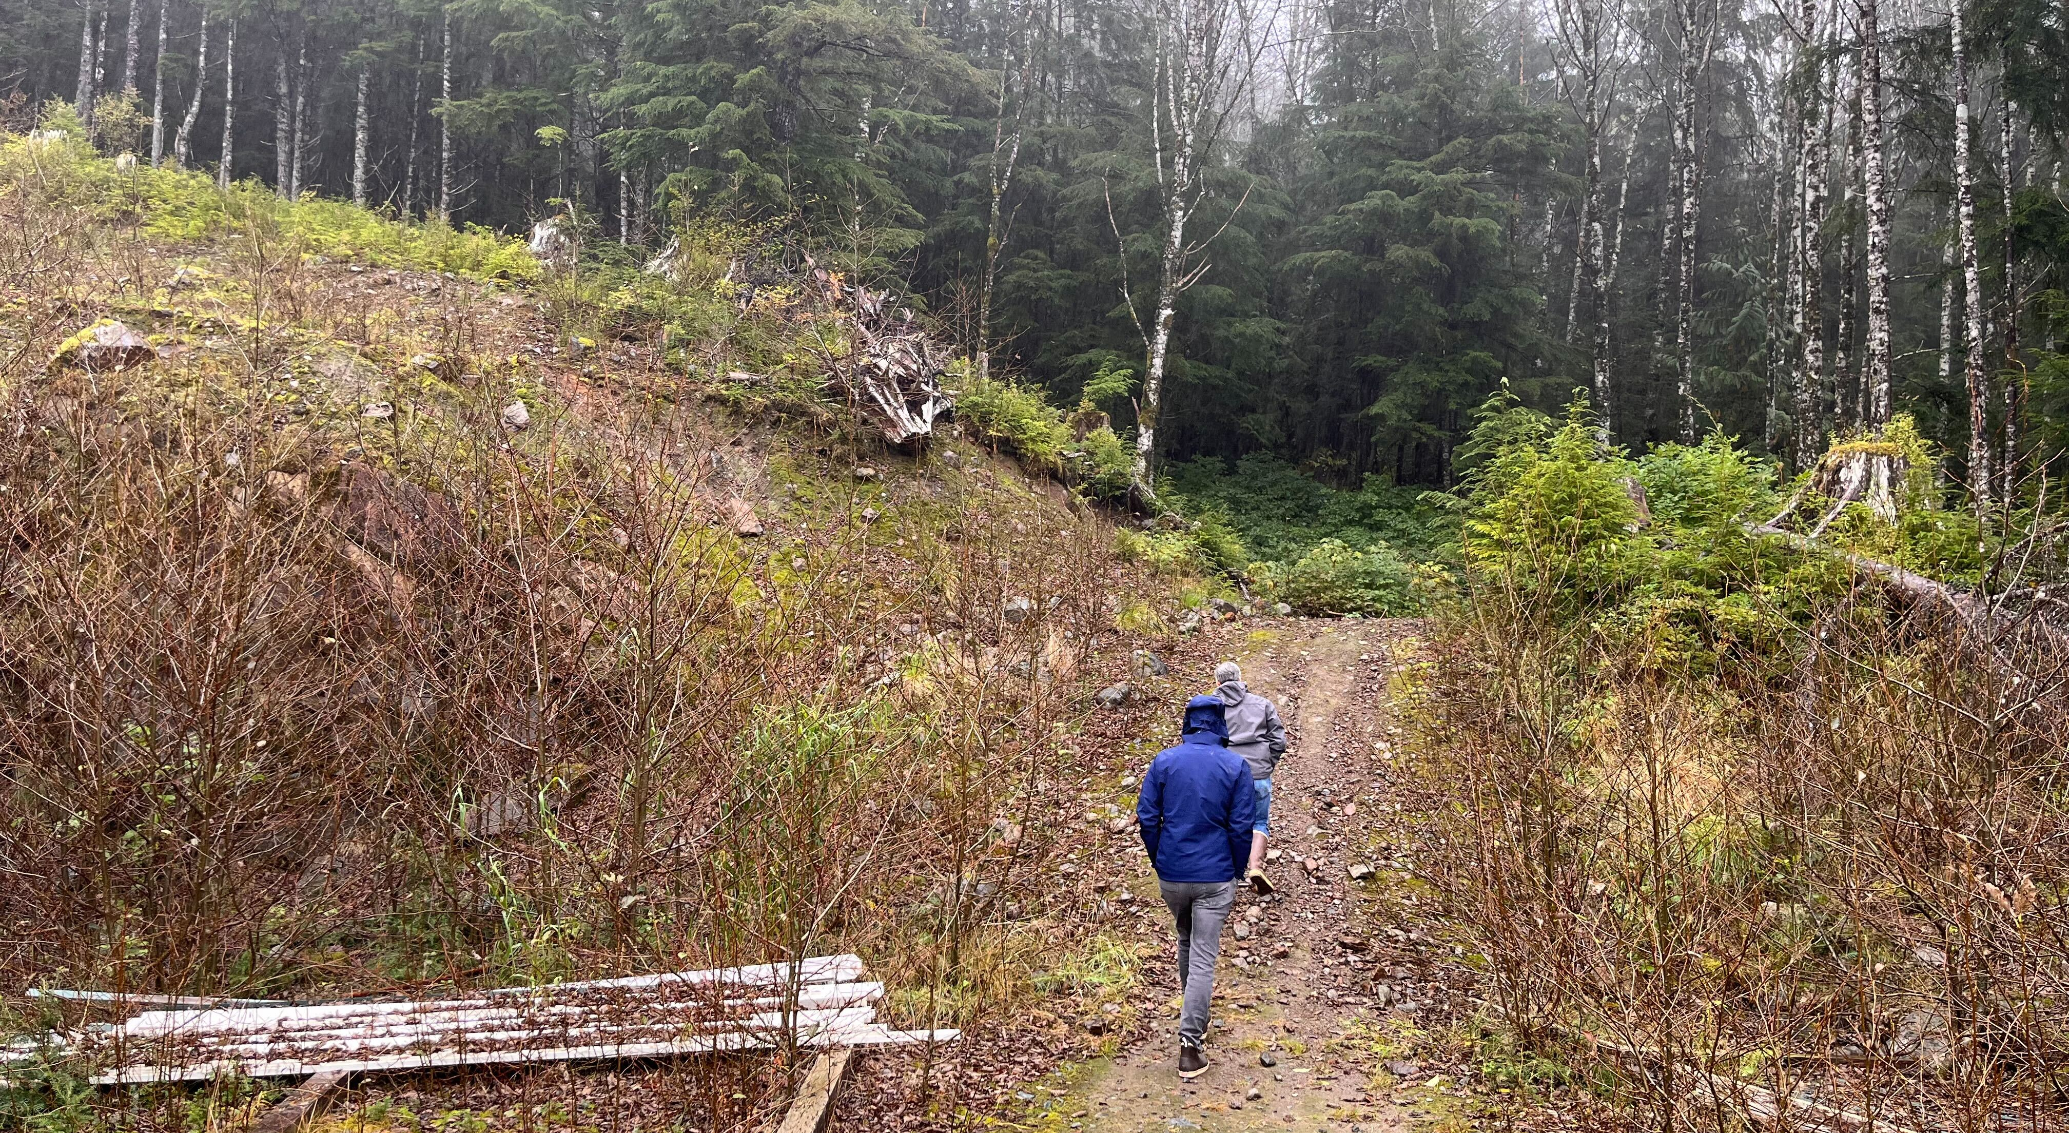
Site Review
Properties viewed for Feasibility Analysis:
Fawn Mountain
Revilla Road (Ward Cove)
Old Dairy Road
17/18 mile
PC On-Site visit, October 2023

Slide 6
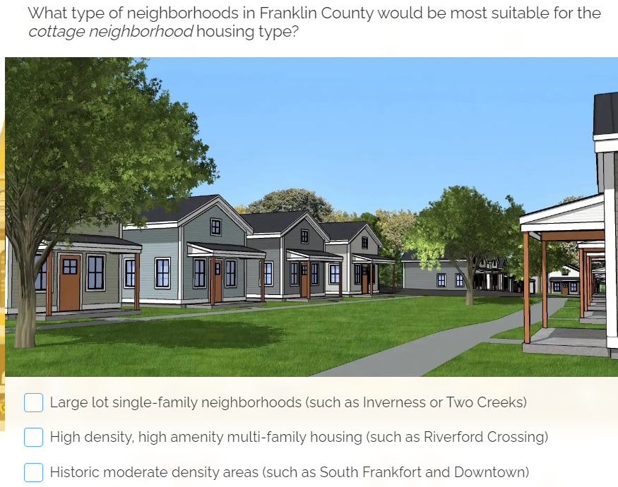
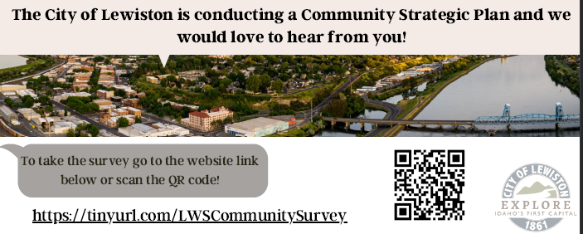
Community Survey Logistics
Via SurveyLegend
Multimodal marketing: Facebook, LinkedIn, local news outlets
Utilities mailers? Posted flyers?
Recent response rates:
Housing Needs Market Study Survey for the City of Montrose Colorado: 1,236 responses | 4.3% response rate.
Comprehensive Economic Development Strategic Plan Community Survey for the Confederated Tribes of Umatilla Indian Reservation (CTUIR): 155 responses | 5.3% response rate.
Community Strategic Plan Survey for the City of Lewiston Idaho: 1,520 responses | 4.5% response rate.

Slide 7
In-Depth Interviews
Michelle O'Brien - Chamber of Commerce Executive Director
Deborah Hayden - Grow Ketchikan Executive Director
Mary Wanzer - Coastal Keller Williams Realty, Alaska Group
Ruben Duran - Ketchikan Gateway Borough Manager
Bess Clark - Community Connections
Richard Harney - Ketchikan Indian Community Tribal Planner
Ty Rettke - PATH Shelter
Lacey Simpson – Ketchikan Assistant City Manager
Priscilla Schulte - University of Alaska Southeast Campus Director
Kate Govaars - PeaceHealth Medical Center
Michael Medford - First Bank
Bill Rotecki - Rainforest Construction

Slide 8

Example Presentation by PC
Scope of Work: Tasks 5-7
Task 5: Gap & Barriers Assessment
summary of findings
economic gaps between supply and demand
housing demand forecast (1-year, 5-years, and 20-years)
best practices from similar communities
suggested modifications for housing developments
policy and zoning alterations recommendations
recommended strategies for increasing housing affordability and choices
identification of funding sources
Task 6: Implementation Plan
Identification/organization of public-private partnerships (for-profit developers, financial institutions, government agencies, non-profits etc.)
Task 7: Final Deliverables & Presentation
final feedback integration
final reports (updated 2019 CHAP, 2010 Ketchikan Economic Indicators, and new Economic and Housing Market Indicators and Forecast Reports)
presentations to Ketchikan borough/city leadership and Chamber of Commerce

Slide 9
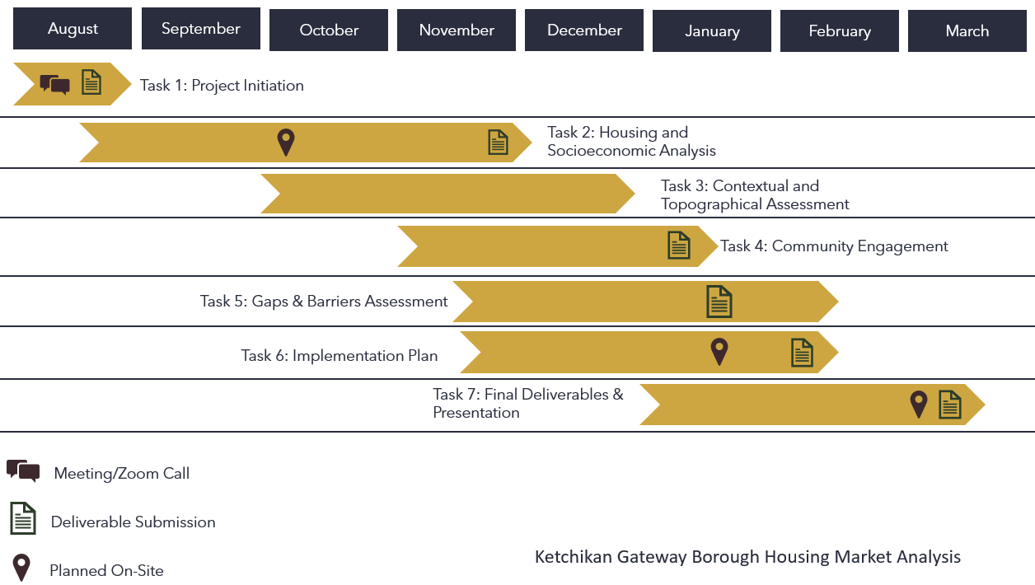
Project Timeline

Slide 10
Q&A

