Slide 1

Ketchikan Housing Market Analysis
For: The Ketchikan Gateway Borough, AK
By: Points Consulting
October 19th, 2023

Slide 2

Agenda
Project Overview & Update
Community Survey Summary
Policy Related Questions
Demographic & Housing Metrics
Next Steps
Housing Types Preferences

Slide 3
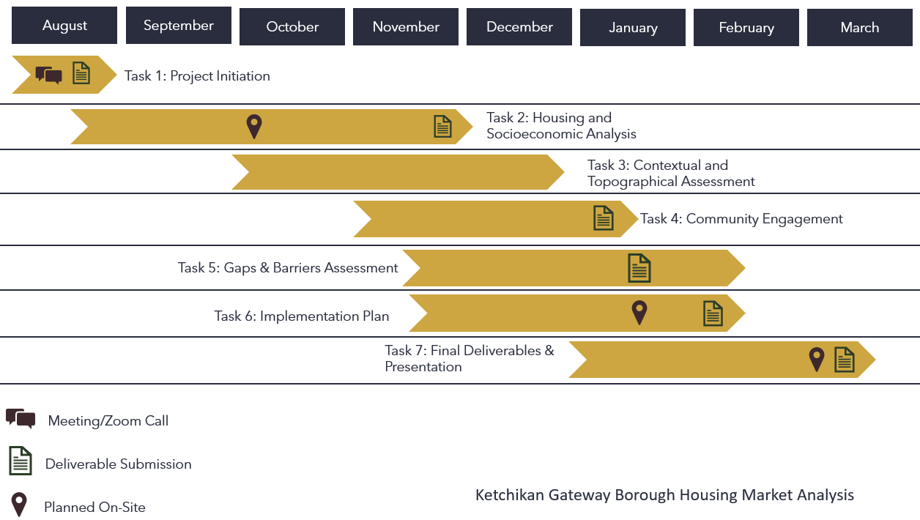
Project Timeline
2023
2024
Notes:
Not pictured, but just FYI, we have a team of 7 who has contributed to this back in the office, particularly Pedro, whose been my co-lead.
Working on now: GIS assessment, finishing survey analysis, finishing up socioeconomic metrics, and prepping for affordability calculations and recommendations. Mid-march final deliverable. I can come back, if needed for another presentation at that point focused on the final results and recommendations.

Slide 4


Why a Housing Study?
Working for both the KGB and its citizens
Everybody has a role in housing: borough, citizens, neighbors, builders/developers, local financial organizations, non-profits, etc.
Market research is a necessary first step to action
We want to know what people are missing…seriously, we really want to know
We want to see something different happen

Slide 5
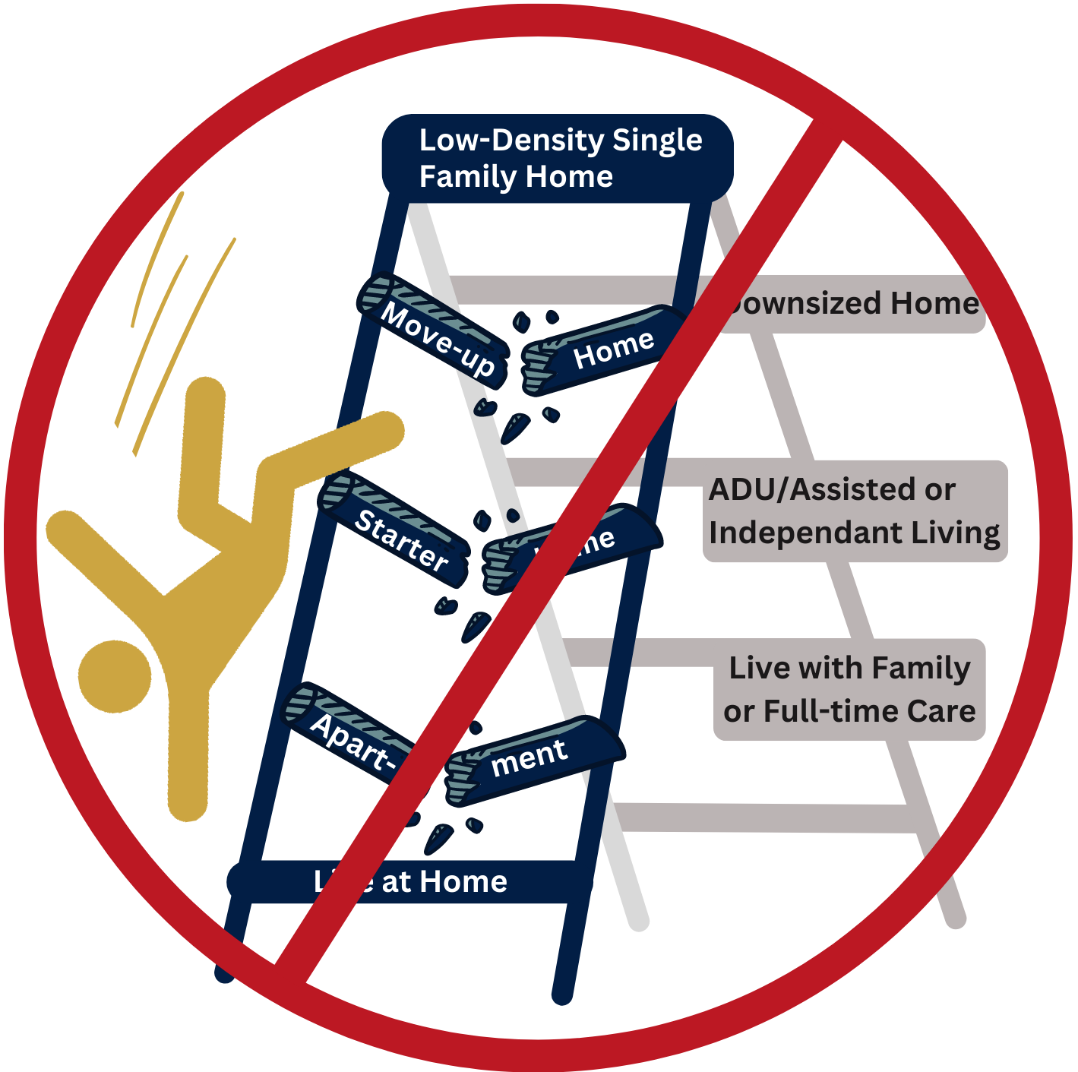
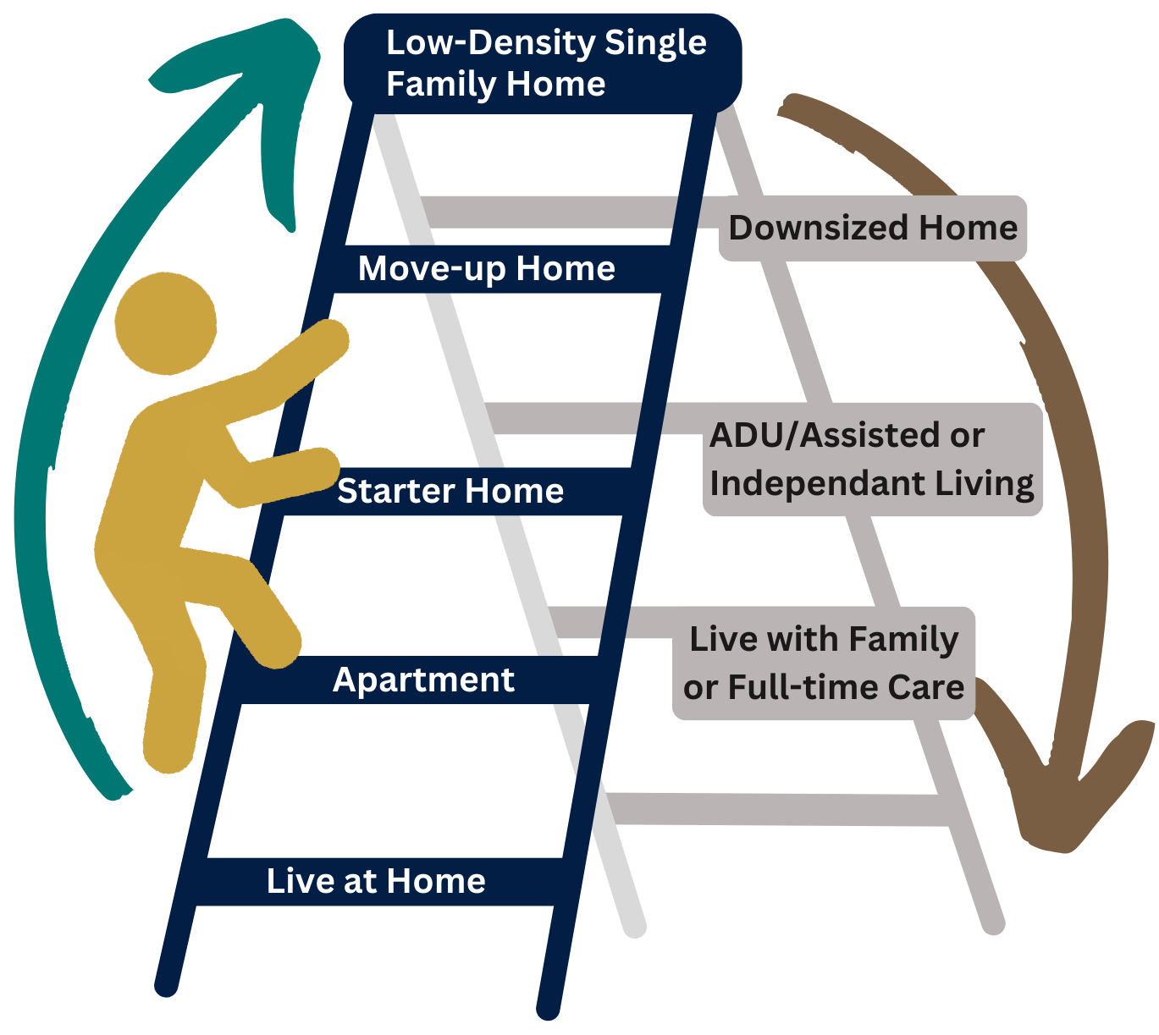
The Housing Ladder
Functional Ladder
Broken Ladder
Notes:
Economic consequences of a broken housing market are real. Sometimes a perception that it’s just a few bellyachers that need to work harder but, in fact, conditions are a lot more challenging and complicated than they were when Boomers and GenXers were coming up. If you don’t get “on” the ladder, you can’t progress with the equity of it.

Slide 6
Key Takeaways (to this Point)
Housing Market
Survey Highlights
Seasonal economy has troublesome impacts on the housing market
Market is signaling for more rentals (increasing price!) but new supply is lagging
Lack of rental supply allows landlords to be very choosy
Population in the KGB has been on a downswing since 2020
Migration to the borough has remained negative since 2018
Even when population is in decline new units are needed (use of housing is less efficient than years past)
High interest housing issues among all generations
Residents are more amenable to middle- and high-density than most communities
For many, a strong sense of frustration and desperation
Most survey takers agree that there are too many short-term rentals and rentals committed to seasonal workers
At the same time, they do not agree that the government can solve this problem

Slide 7
Community Survey Summary
Project Overview & Update
Community Survey Summary
Policy Related Questions
Demographic & Housing Metrics
Next Steps
Housing Types Preferences

Slide 8
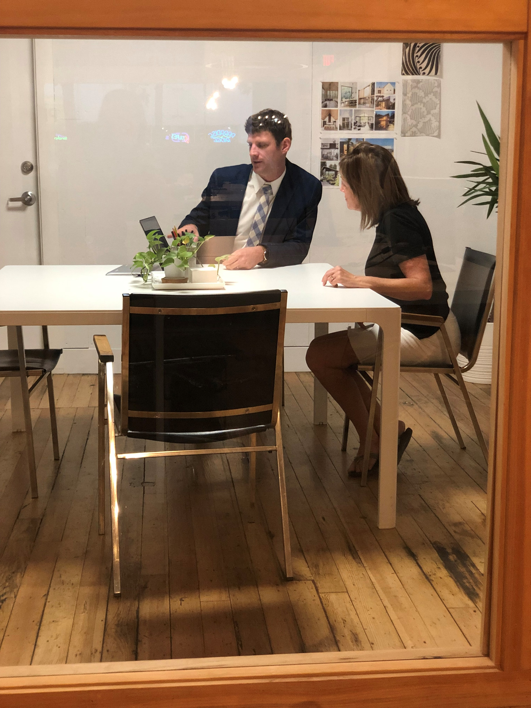
In-Depth Interviews
Michelle O'Brien - Chamber of Commerce Executive Director
Deborah Hayden - Grow Ketchikan Executive Director
Peter Amylon & Morgan Barry- Ketchikan Gateway Borough
Mary Wanzer - Coastal Keller Williams Realty, Alaska Group
Ruben Duran - Ketchikan Gateway Borough Manager
Bess Clark - Community Connections
Richard Harney - Ketchikan Indian Community Tribal Planner
Ty Rettke - PATH Shelter
Lacey Simpson – Ketchikan Assistant City Manager
Priscilla Schulte - University of Alaska Southeast Campus Director
Kate Govaars - PeaceHealth Medical Center
Michael Medford - First Bank
Bill Rotecki - Rainforest Construction
Myrna Chaney- Ketchikan Indian Community
Mayor David Kiffer- City of Ketchikan
Agnes Moran & Eryn Ruppert- Women in Safe Homes
Notes:
List of 18 individual interviewed to date, we are open to more. In some cases, potential community partners have been unresponsive to multiple inquires for interviews. (Also, to be fair, we have also read the reports and presentations of some of these groups, or they took the survey, so they don’t feel that they need to respond.

Slide 9
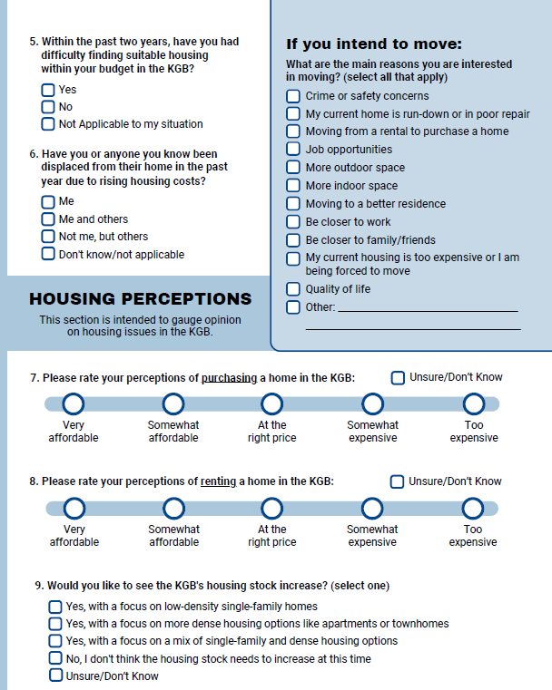
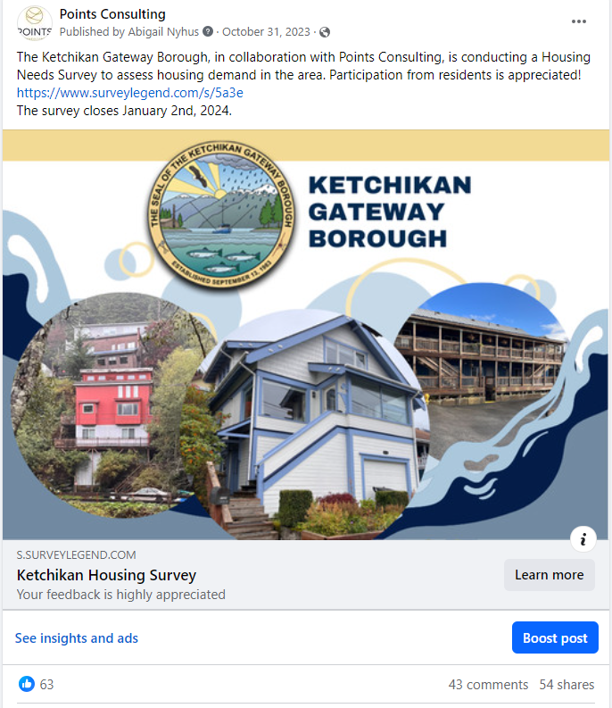
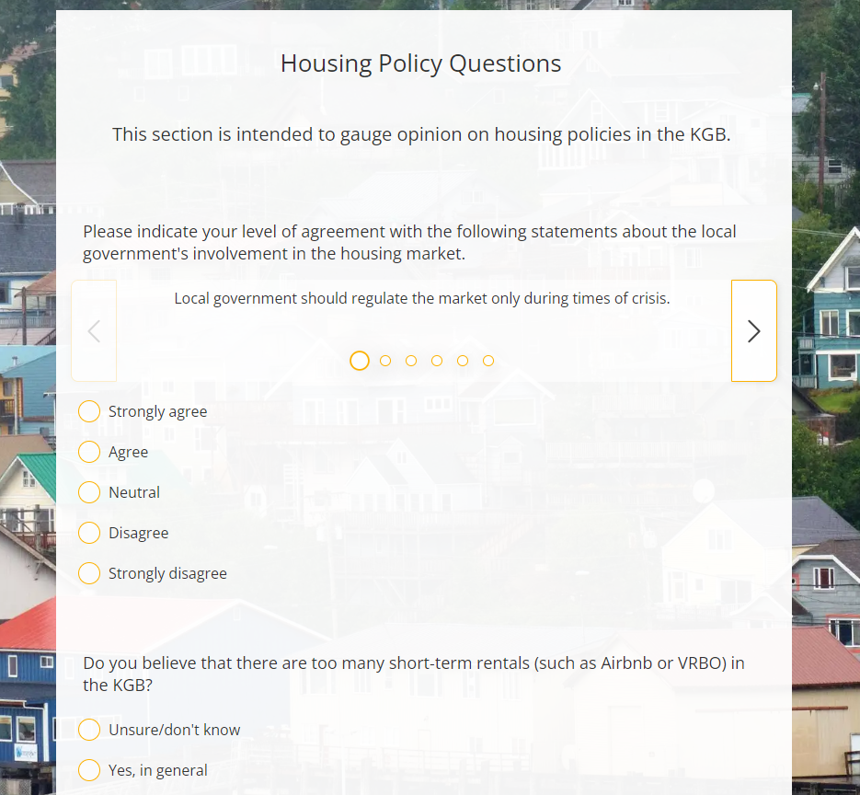
Survey Background
Qualified responses:
  Total: 1,151
  Residents of the KGB: 1,117
Dates open:​
  Oct. 31 through Jan. 2, 2023
Distribution Methods:​
  Social Media Promotion (Facebook)​
    Reach: 6,523
    Post Engagements: 962
    Strongest among 25- to 44-year-olds
  Paper Surveys collected from homeless shelters and KGB office: 67
  Ads on public transit busses

Slide 10
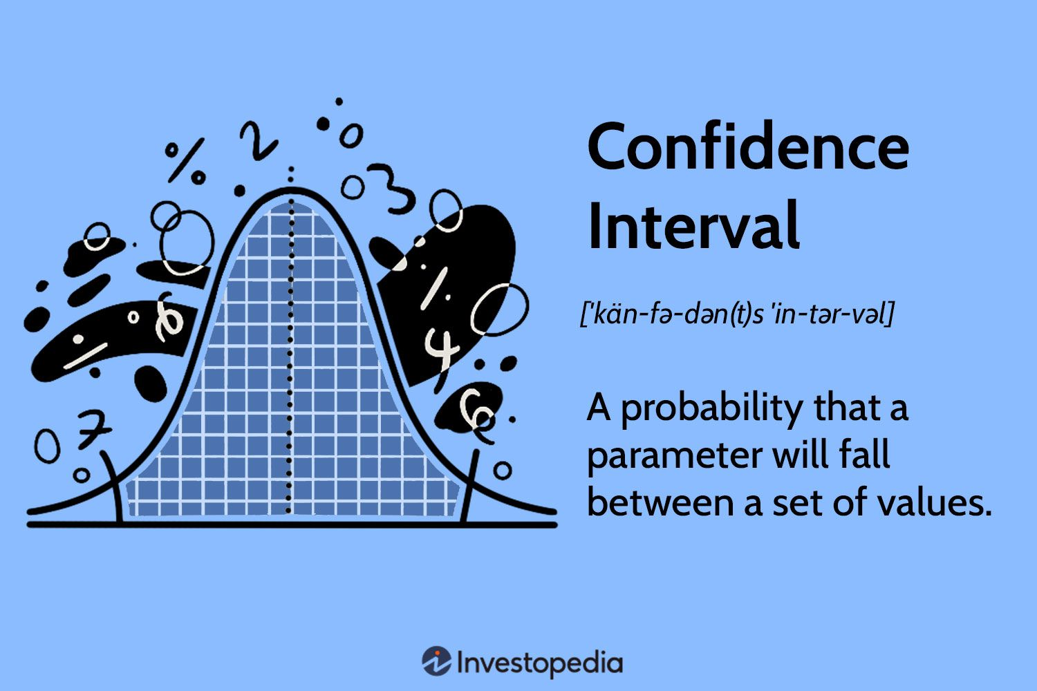
Survey Reliability
We do not need to survey every citizen to get a representative and statistically significant sample
Response Rate: 10.2%*​
  Confidence Interval (C.I.): 99%
  Margin of error (M.O.E.): ±4%
In English…
We are confident that the actual sentiments of KGB residents are reflected in this survey (within 4% in either direction)
For example: 85% of respondents answered “Yes” to the question: “Would you like to see the KGB's housing stock increase?”
Somewhere between 89% and 81% of the borough’s entire population feels this way
*Response rate based on adult residents in the Ketchikan Gateway Borough as of 2022 and number of survey respondents verifiably residing in Broken Arrow
Notes:
Very successful rate
PC treats the data in several ways prior to presenting to ensure that it isn’t biased, including:
Removal of suspicious responses (too fast, strange IP address, immaterial input, etc.)
Removal of people who neither live nor work in the KGB, and who have no interest in moving to BA
Recoding people with “other” responses who ought to have selected a fixed response
…all told, comparable to the tourism survey that was completed recently.

Slide 11
Who Took the Survey?
Very evenly distributed by generation (median age of 50)
Mostly 2 or 3 family households
Employed full-time, employed part-time and retired account for majority of respondents
Median residency duration: 12 years

Slide 12
Have you struggled to find affordable housing in the KGB in the last two years?
Affordability & Displacement
Have you or anyone you know been displaced from their home in the past year due to rising housing costs?
Notes:
Obviously drew the interest of a lot of people who are actually in the housing market (or rental market), currently.
The displacement rate is extremely high. This is collected across socioeconomic levels, and oftentimes people do not know people outside of their level. But, 61% (regardless of socioeconomics) know people who’ve been displaces, is really something.

Slide 13
Perceived Purchase Costs
Housing Cost Perceptions
Perceived Rent Costs
Notes:
Interesting that the cost perceptions were roughly equal between purchase and rentals.
Difference compared to average for other communities (based on Montrose, KY, WP, and COBA): 74% of KGB residents said purchasing a home was too expensive—compared to an average of 43% for other communities!
Similarly, 72% of KGB residents that took the survey mentioned that renting a home was too expensive, compared to an average of 46% in other communities.

Slide 14
Would you like to see the KGB's housing stock increase?
For one reason or another, most residents (85%) want to see more housing units
Populations less interested in more housing include retirees and KGB residents of 11 years +
Those who support more housing options include seasonal workers and those who live in MFH and group homes.
N = 1,012
Notes:
A great majority (86%) of respondents would like to see the housing stock increase.

Slide 15
Policy Related Survey Questions
Project Overview & Update
Community Survey Summary
Policy Related Questions
Demographic & Housing Metrics
Next Steps
Housing Types Preferences

Slide 16
What role should the government have in the housing market?
Notes:
The community, at large, wants and expects a level of planning on housing and land use.

Slide 17
What tools should the local government use to promote housing development?
N = 846
Notes:
IN terms of involvement, 468 are interested in “incentives for development of affordable units,” which is much higher than our typical observation.
To a degree I think lack of familiarity with terms contributors to answers here (things like “deed restrictions” aren’t common parlance). Also, things like “zoning changes for diverse housing types” isn’t something most people realize can have an effect.

Slide 18
​Do you believe that there are too many short-term rentals (such as Airbnb or VRBO) in the KGB?
Notes:
58% think that there are too many STRS (but not the same as saying that the government should fix that problem). Others could hope/expect the market to fix it.

Slide 19
What forms of regulation should be enforced on short-term rentals?
Notes:
Somewhat surprising that the most restrictive option is the most popular here. But, keep in mind that many people skipped this question, so among those who took the survey overall, it’s just 34% of respondents in favor of local residency (but that is still a lot)!
Using that same denominator, just 13% are in favor of laissez faire treatment (or no regulation).

Slide 20
Housing Type Preferences
Project Overview & Update
Community Survey Summary
Policy Related Questions
Demographic & Housing Metrics
Next Steps
Housing Types Preferences

Slide 21

Geographic preferences for housing types
Respondents were asked what housing types would be most suitable for various neighborhoods throughout the KGB. The questions were accompanied by proto-typical renderings of such housing types:
Large lot single-family neighborhoods (half-acre lots and above)
Moderately sized single-family neighborhoods (quarter-acre to half-acre lots)
Urban-density single-family neighborhoods (lots of 6,500 sq. ft and below)
Areas on or just behind commercial corridors
Around low-density multi-family housing (such as duplexes and townhomes)
High-density apartment areas
Everywhere
Nowhere
Notes:
This is our best effort to combat NIMBY-ism. Not allowed to say that housing is fine in theory; you must say where or you can say nowhere, which is a really extreme version of NIMBYism. These do not match perfectly with KGB zoning (usually people aren’t that aware of zoning), but there are loose matches with things like RL, (low density residential) and the first group, and RM (medium density residential) and the second choice.

Slide 22
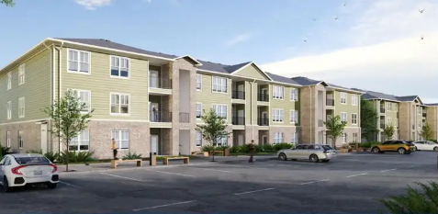
What type of neighborhoods in the KGB would be most suitable for the multifamily/apartment housing type?
N = 769
Notes:
Naturally, people want apartments in high-density areas, which fits with the definition. Looking at areas near transit and commercial corridors is another option if looking for more land for multi-family.

Slide 23
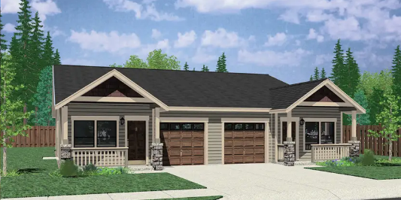
What type of neighborhoods in the KGB would be most suitable for the duplex and triplex housing type?
N = 792
Notes:
People perceive that duplex/triplexes are in the middle (i.e. not apartments and not detached homes) but they think of them more like detached SFHs than multifamily. This is actually the opposite instinct from what we see in most communities in the lower 48.

Slide 24
What type of neighborhoods in the KGB would be most suitable for the manufactured home community housing type?
N = 757
Notes:
Even more crazy…people would love to see some manufactured home communities. Just some separation from large lot SFH. There are developers who specialize in this.

Slide 25
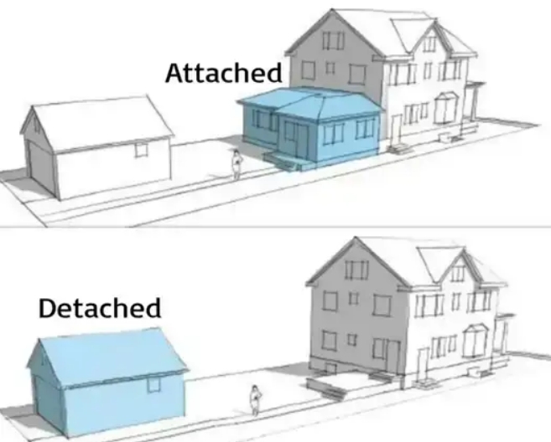
What type of neighborhoods in the KGB would be most suitable for the accessory dwelling unit (ADU) housing type?
N = 741
Notes:
Lastly, for areas that need more units but still have density hesitancy…ADUs. Everywhere is the most common response (probably not a great idea, honestly) but the next two are pretty sensible, many larger lots can fit more housing units. Fits with an aging population interested in aging in place, as well.

Slide 26
Demographic & Housing Metrics
Project Overview & Update
Community Survey Summary
Policy Related Questions
Demographic & Housing Metrics
Next Steps
Housing Types Preferences
Notes:
This is just an assortment of some of the many socioeconomics. Not a lot of time to dwell on these but gives you a sense of the situation.

Slide 27
Living Wage in the KGB
Source: MIT Living Wage Calculator, 2023
Notes:
Expresses the cost of living difficulty of KGB. Some people said this exact thing in the survey, almost impossible for a household to make it unless two adults are working.

Slide 28
Projected Population Change & Migration to/from the KGB
Source : Alaska Department of Labor and Workforce Development, Alaska Population Projections, 2021-2050
Source: US Census Bureau, Population and Housing Unit Estimates, 2022
Notes:
Note how the state projects a decrease, and a pretty radical one at that, for the KGB. We will generate our own forecast, b/c this is probably overly pessimistic. But, it is safe to assume some decline.
You can see the ingredients of this on the right. more deaths than births, and net migration has negative for 9 of the past 10 years.
BUT, remember housing supply can be effected by other dynamics. Some are more obvious: STRs, high vacancy seasonal rentals. But also, less obvious things like second/third homes (again, that is a higher rate of vacancy), and also lower occupancy per household (from 3.1 persons per household now to 2.4) that ads up over a lot of units.
Honestly, it is possible to overbuild in Ketchikan given that population will not significantly increase, But this is really a question of how deep is the market for STRs and seasonal rentals if it is unconstrained? B/c if that is accounting for 1/8, 1/5 or 1/3 of the units, you could still have a shortage.

Slide 29
New Housing Production in the KGB
20.8
Source: Alaska Department of Labor and Workforce Development, Alaska Housing Information, 2023
Source: Alaska Department of Labor and Workforce Development, Alaska Housing Information, 2023
Notes:
All that considered, the question is, is this enough production to keep up? SFH is more stable and MFH is very hit and miss.

Slide 30
Next Steps
Odds and ends to existing draft report
Housing forecast to 2043 by low, middle and high-density levels
Recommendations and best practices
Draft Report: ~ February 29, 2024
Final Report: ~ March 15, 2024

Slide 31
Survey Comments
I am a full-time year round employed person making nearly 60k a year and it is a STRUGLE to find housing here in Ketchikan. In the 7 years I have lived here my rent has increased 62% from when I first stated renting.
We have eight rental units… all Long-Term save for one. The very sad reality is that there a LOT of individuals in this Community that are frankly, simply UNHOUSEABLE…due to drug use/addiction, low-education and thus low-income (not meeting sensible income/rent ratios).
If I lose my voucher before finding somewhere to spend my daughters last years of adolescence in our own space it will not only affect my future but the future of my girls. Living in a home where you feel you’ve outstayed your welcome & have zero privacy or independence puts a massive strain on the quality of all involved lives.
I was recruited here last winter to do professional work that's badly needed. It took me 5 months to get a modest apartment for $1900 and anything I could buy is snapped up quick, usually for short term rentals. I feel guilty for taking up housing at all when long term locals can't afford what I pay and I'm terrified of what will happen when my lease is up next June.

